Slide 1
Module 2
Chi-square tests to analyze categorical data

Slide 2
Topics
Chi-square test for one categorical (or qualitative) variable.
Chi square test for two categorical (or qualitative) variables.

Slide 3
Qualitative or Categorical Variables
Variables whose values represent labels or categories, rather than numerical quantities.
Examples:
Eye color: Black, Brown, Blue, and Green.
Nationality: US and Not US.
US Region: South, West, East, and North.

Slide 4
Chi-square test for one qualitative variable (also known as the chi-square goodness of fit test)
We have one categorical variable with K categories.
We want to make an inference about the probability (percentage) associated with each category.
We have an hypothesis about the possible values of these probabilities.
We want to find out if the data support our hypothesized probabilities.

Slide 5
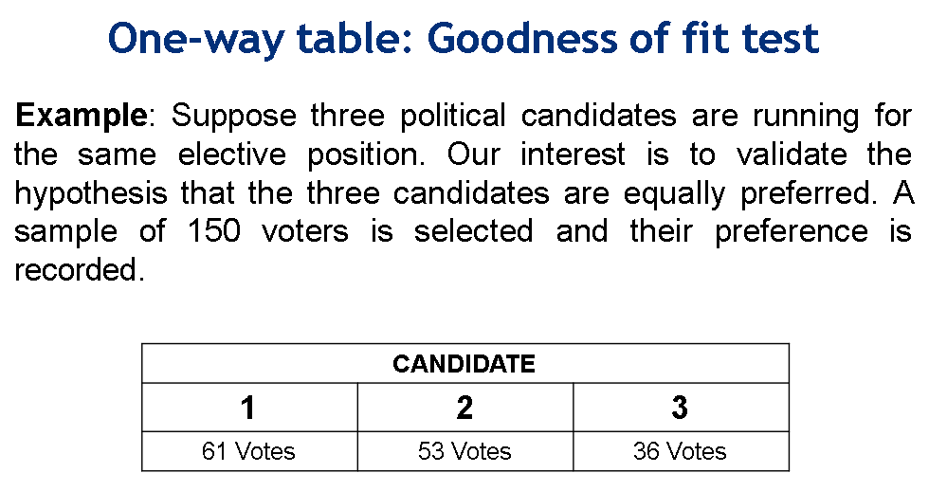

Slide 6
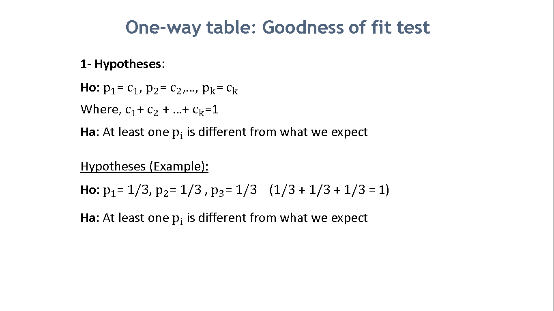

Slide 7
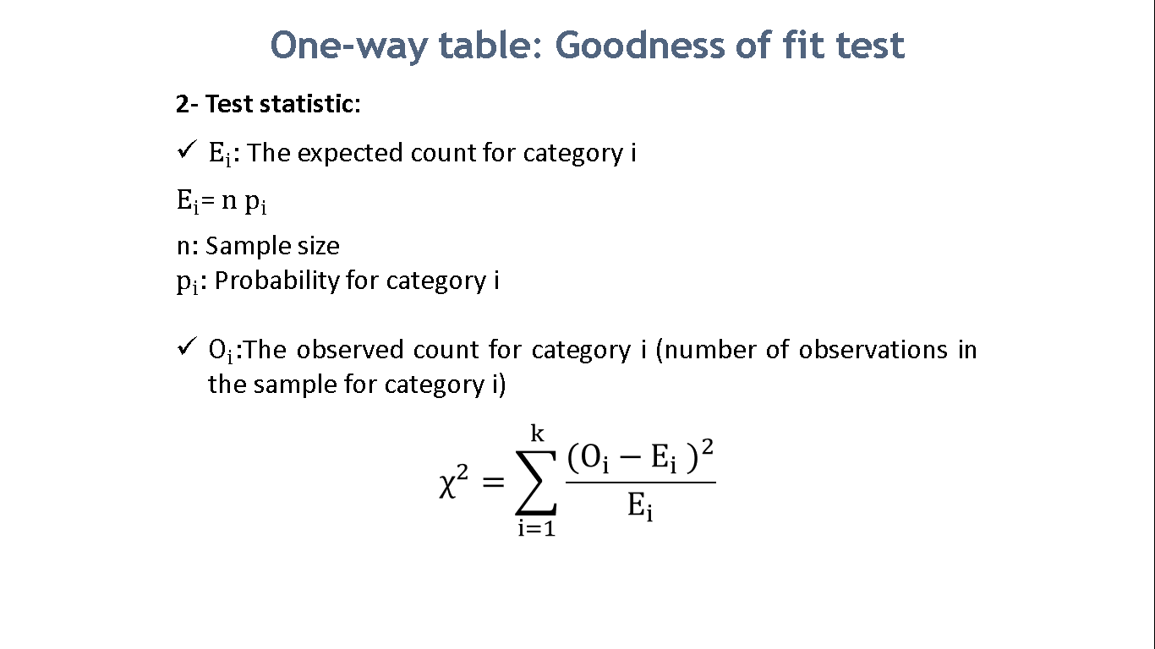

Slide 8
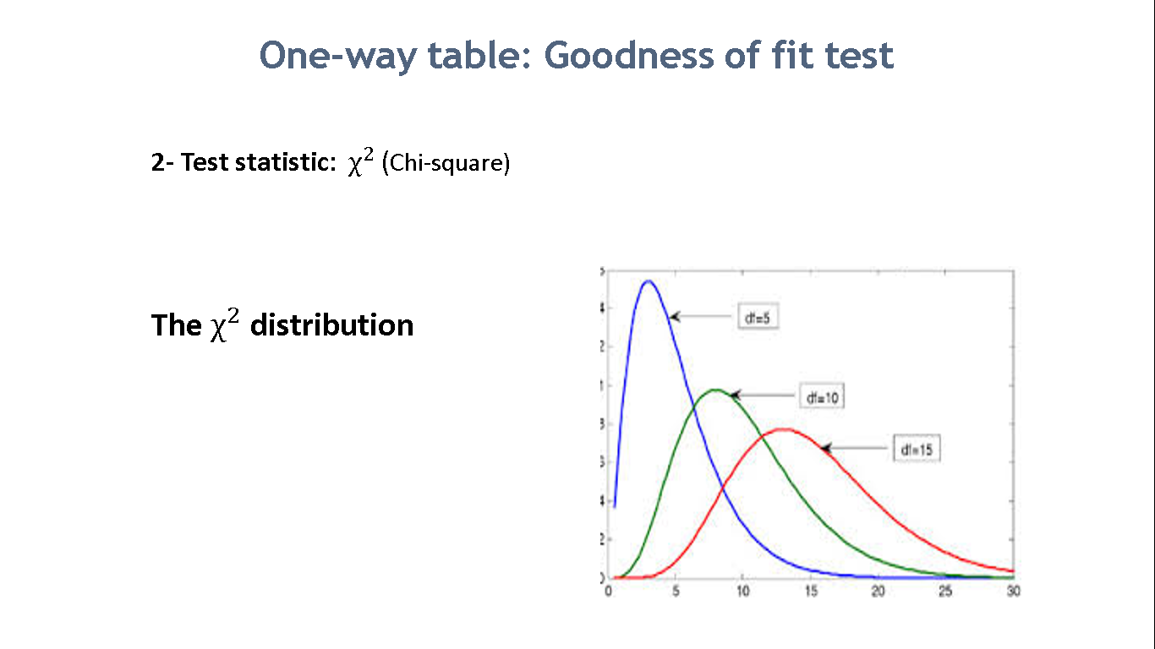

Slide 9
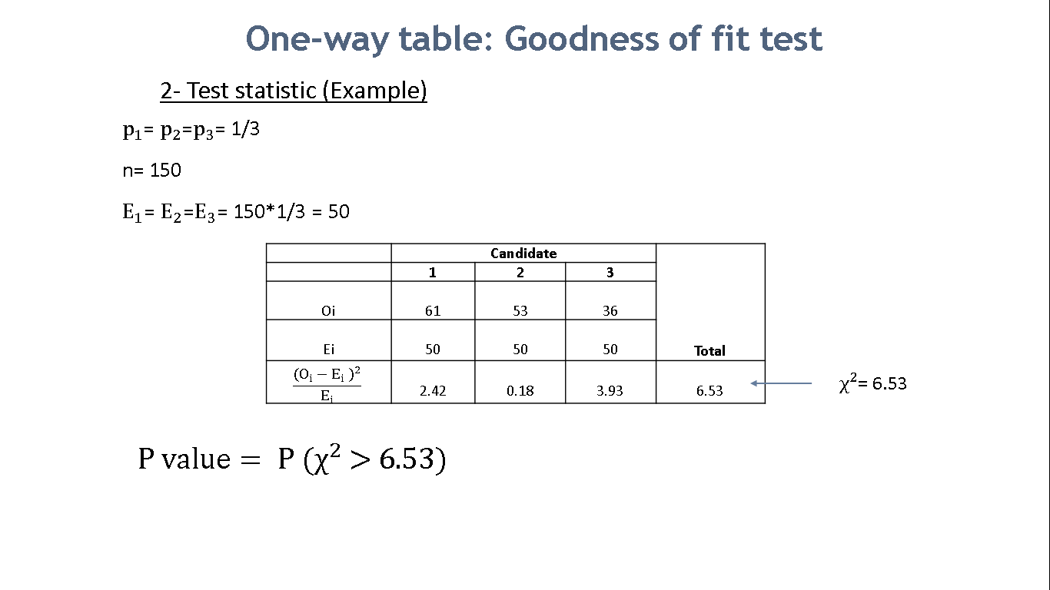

Slide 10
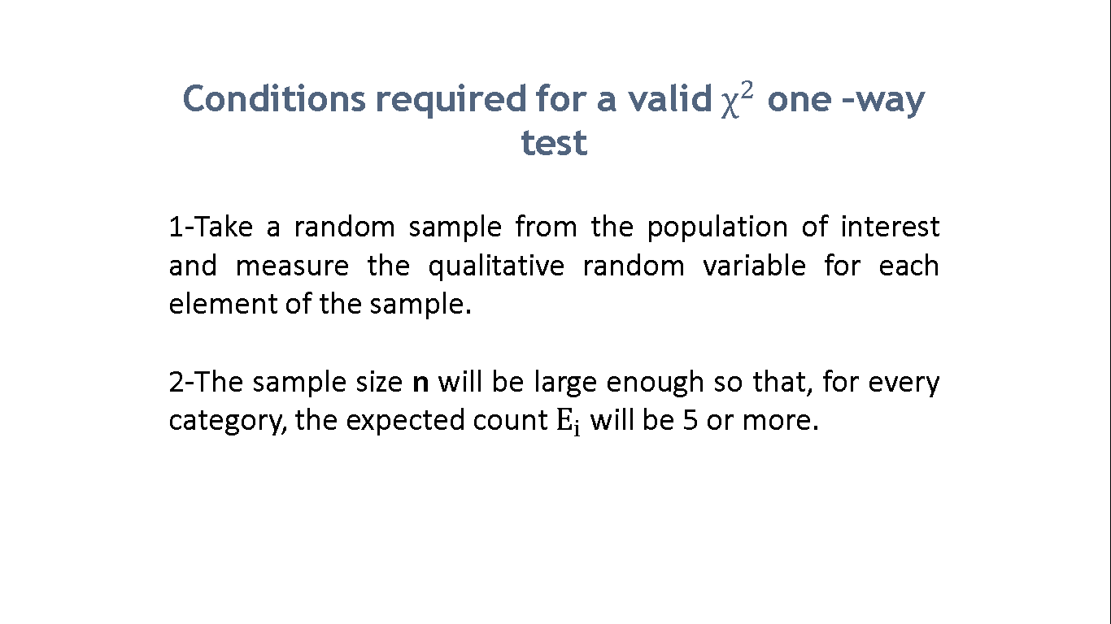

Slide 11
Pearson residuals
When Ho is rejected and Ha is supported, the analyst usually wants to know what categories are farther away from the expected probabilities and in what direction. To do this, you can compute the Pearson residuals.
Pearson residuals measure how far each observed count is from its expected count.
Notes:
Pearson residuals measure how far each observed count is from its expected count, in units of standard deviations. The standard deviation of a Poisson random variable associated to the observed count for each category, which equals the square root of the expected count.

Slide 12
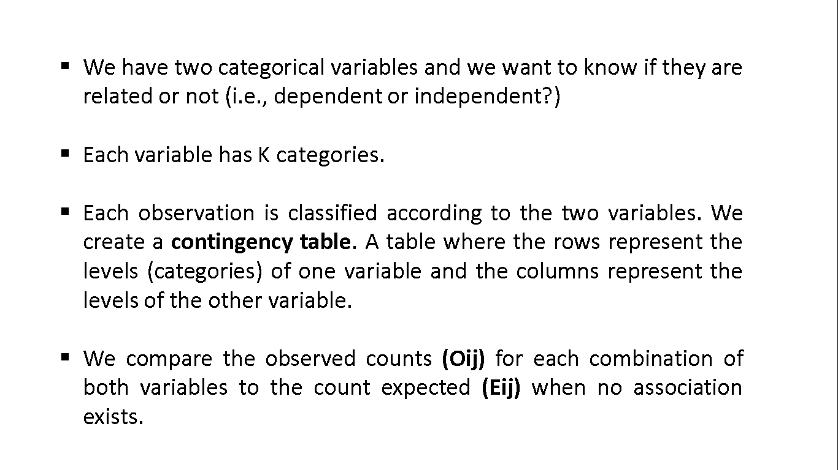
Chi-square test for two qualitative variables (chi-square test of independence)

Slide 13
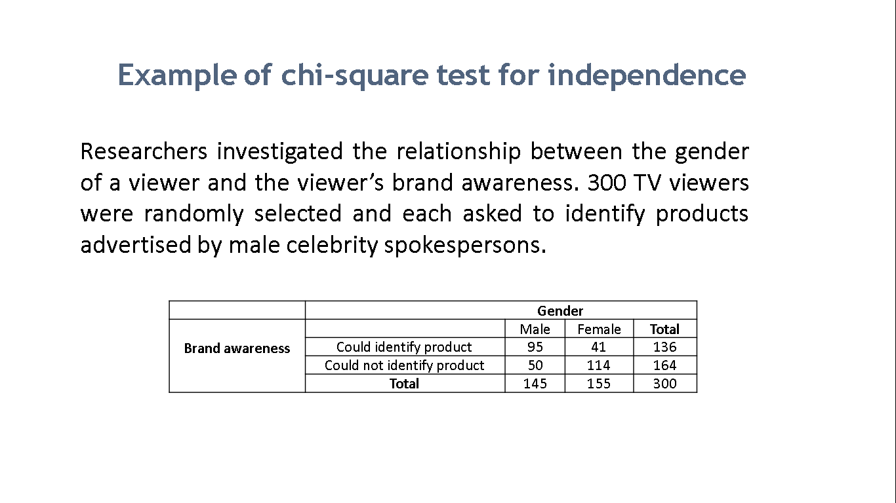

Slide 14
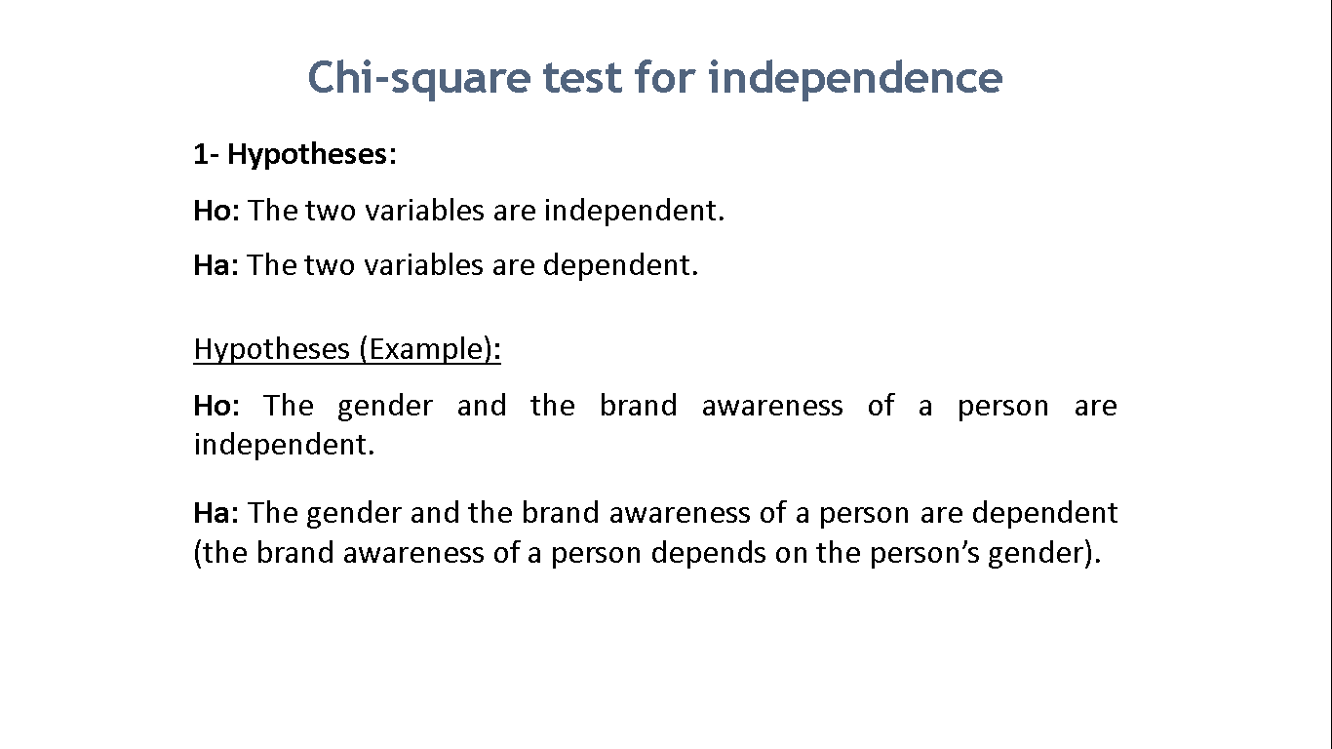

Slide 15
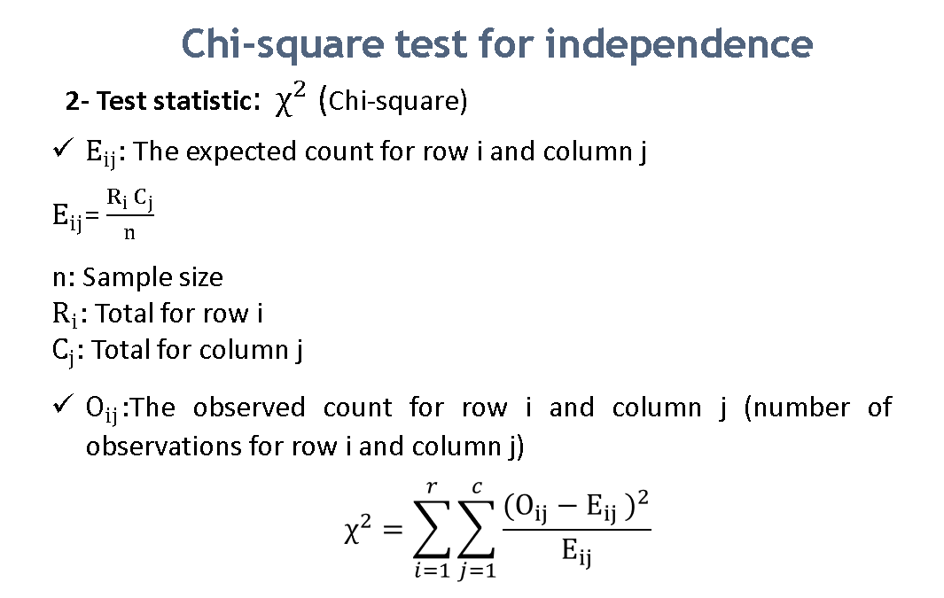
DF = (# rows -1) * (# cols -1)

Slide 16
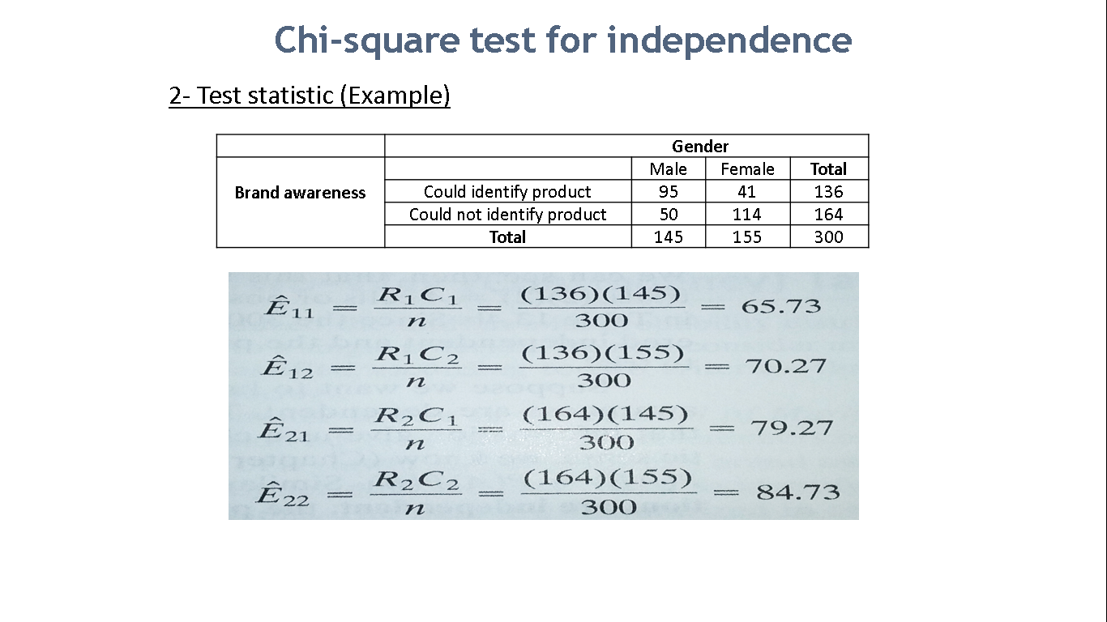

Slide 17
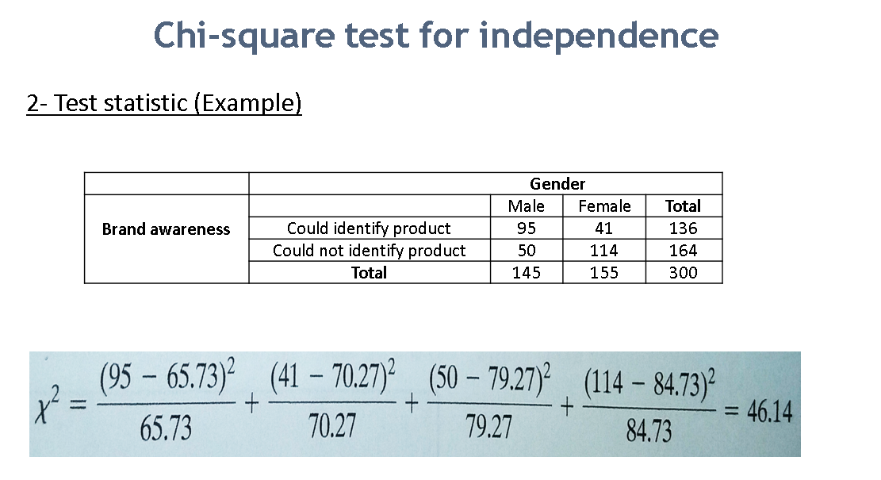

Slide 18

Similarly to the chi-square test for one variable, here you can also compute Pearson residuals.
We usually look for the cells with the largest residuals in absolute value because these cells correspond to categories with strong dependency (which could be a negative or positive dependency depending on the sign).

Slide 19
Chi-square test for two qualitative variables: Practical significance.
Cramer’s V
Cramér’s V is a number between 0 and 1 that indicates how strongly two categorical variables are associated.
Whereas a p-value close to zero means that the two variables have a statistically significant relationship (i.e., our variables are very unlikely to be completely unassociated), this does not mean the variables are strongly associated. For example, a weak association in a large sample size may also result in a p value very close to 0.

Slide 20
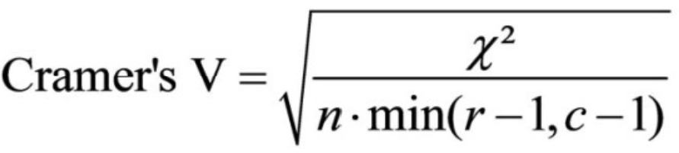
Chi-square test for two qualitative variables: Practical significance.
Cramer’s V
It varies from 0 (= no association between the variables) to 1 (= complete association) and can reach 1 only when each variable is completely determined by the other.
Naive and simplified criteria to interpret Cramer’s V:
C’s V < 0.25, very weak association
0.25 < = C’s V < 0.5 weak to moderate association
0.5 < = C’s V < 0.75 moderate to strong association
C’s V >= 0.75 strong association

Slide 21
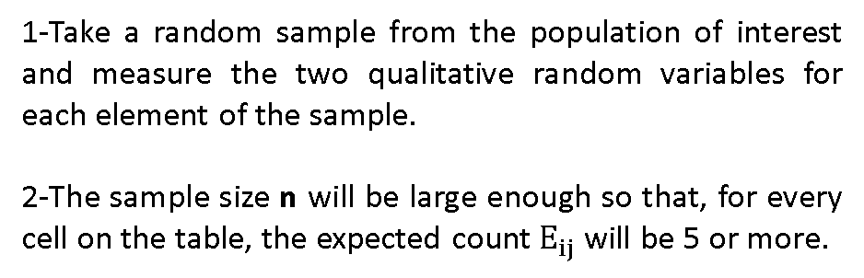
Validity assumptions for the chi-square test for independence

Slide 22
Module 2
Chi-square tests to analyze categorical data

